Slide 1
Financial Assistance for Graduate School

Slide 2
File the Free Application for
Federal Student Aid
If you haven’t already, file the FAFSA at www.studentaid.gov as soon as possible so that we can help you with financial assistance.
Notes:
The first and most important step to receiving financial assistance is the complete the FAFSA.

Slide 3
Student Loan Options
 | Federal Direct Unsubsidized Loan | Federal Graduate PLUS Loan | Private Loan
FAFSA Required? | Yes | Yes | No
Credit Check? | No | Yes | Yes – Student (and cosigner if needed)
Rates | 7.05% Fixed | 8.05% Fixed | Varies by lender (based on credit history of applicant/cosigner)
Borrowing Max | $20,500/year | Up to the yearly cost of attendance after other aid and Unsubsidized Loan | Up to the yearly cost of attendance after other aid and federal loans.
Application Process | Complete the FAFSA, school offers loan amount | Studentaid.gov | uakron.edu/finaid/loan-programs
Notes:
Students primarily use student loans to help pay for graduate school. These are the three types of loans that you can borrow.

Slide 4
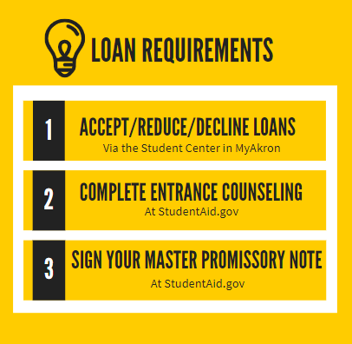
Borrowing Student Loans?
All students need to accept their federal direct student loans in the Student Center of MyAkron, every financial aid year.
First-time student loan borrowers need to complete two additional requirements the first time they borrow loans at UA:
Entrance counseling
Loan Agreement/Master Promissory Note (MPN)
Both of these can be completed online at studentaid.gov with the student’s FSA ID (username and password)
Notes:
If you do borrow, don’t forget to complete any steps that you might not have completed as an undergraduate and remember that you have to accept loans EVERY year.

Slide 5
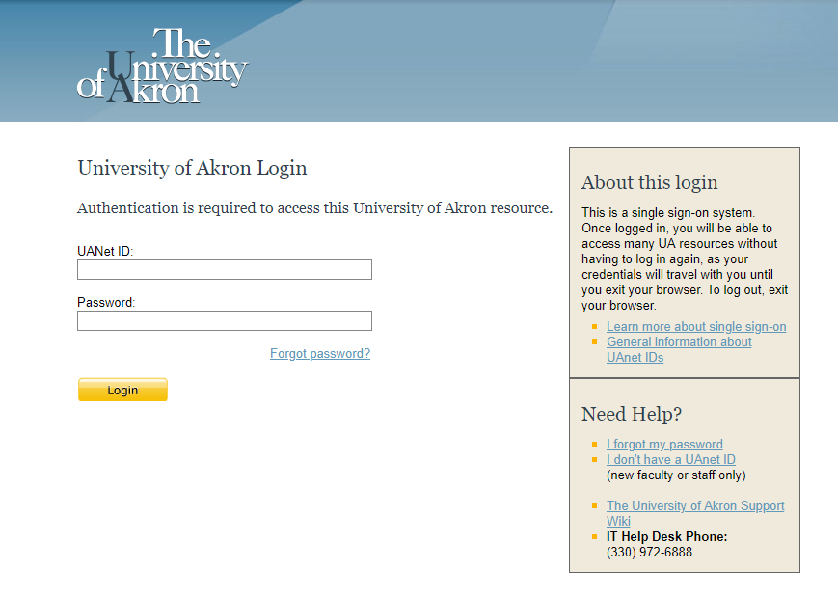
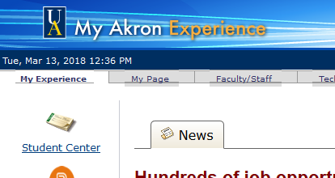
MyAkron Student Center
Access to all financial aid information
https://my.uakron.edu
Students log in with the UANet ID and password (emailed from Admissions)
Notes:
Your student center is the hub for all of your financial aid information.

Slide 6
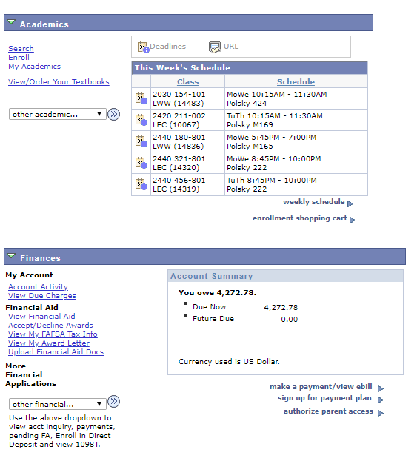
Notes:
This is where you go to accept or decline your student loans.

Slide 7
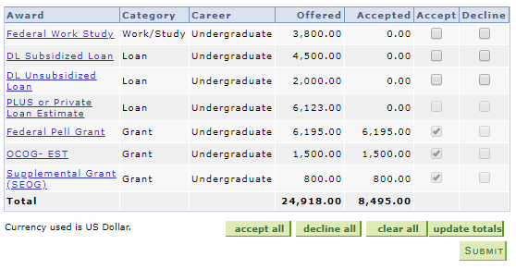
Accept/Decline/Reduce Awards
Check each award you wish to accept or decline (you can also reduce)
Graduate students will see the DL Unsubsidized Loan Offer and an estimate of their Graduate PLUS Loan eligibility. Any estimated graduate remission that you are receiving will show up here for informational purposes as well.
Notes:
This is an example of an undergraduate student, but you will also have the option to accept or decline student loans from this screen in your student center.

Slide 8
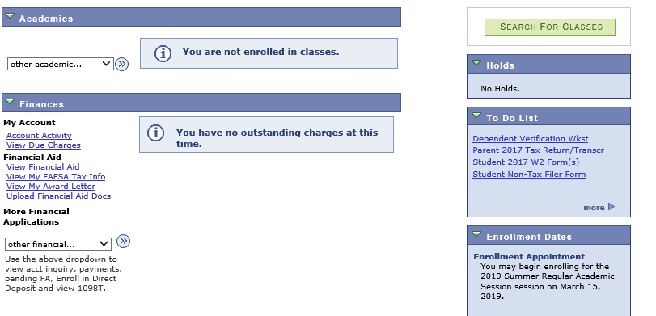
No awards offered? You may be missing something, check your To Do List.
Click on the links for more information and forms. Check your mail and email for original request and reminders.
Notes:
I you completed the FAFSA, but haven’t received a loan offer, check your To Do list for missing items.

Slide 9
Visit the Office of Student Financial Aid
Walk-ins welcome daily from
8 a.m. to 4:30 p.m.
Call center support and live chat available 24/7/365.
uakron.edusupportcenter.com
Simmons Hall Room 204
330-972-7032
Notes:
We take walk-in visitors throughout the day, so please stop by and see us!

